Slide 1


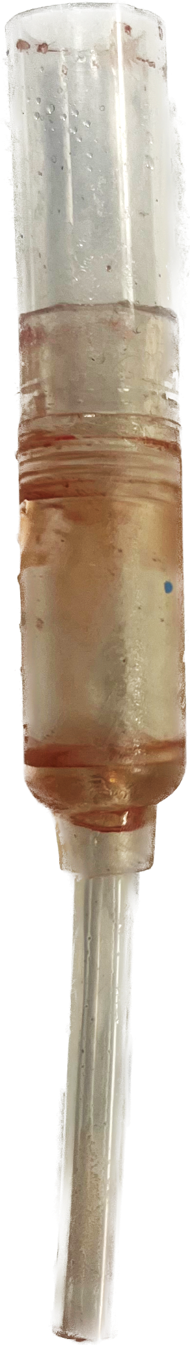
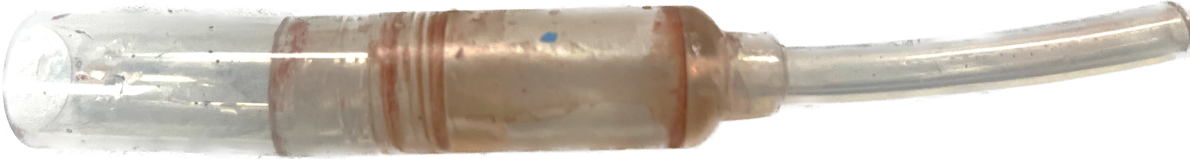
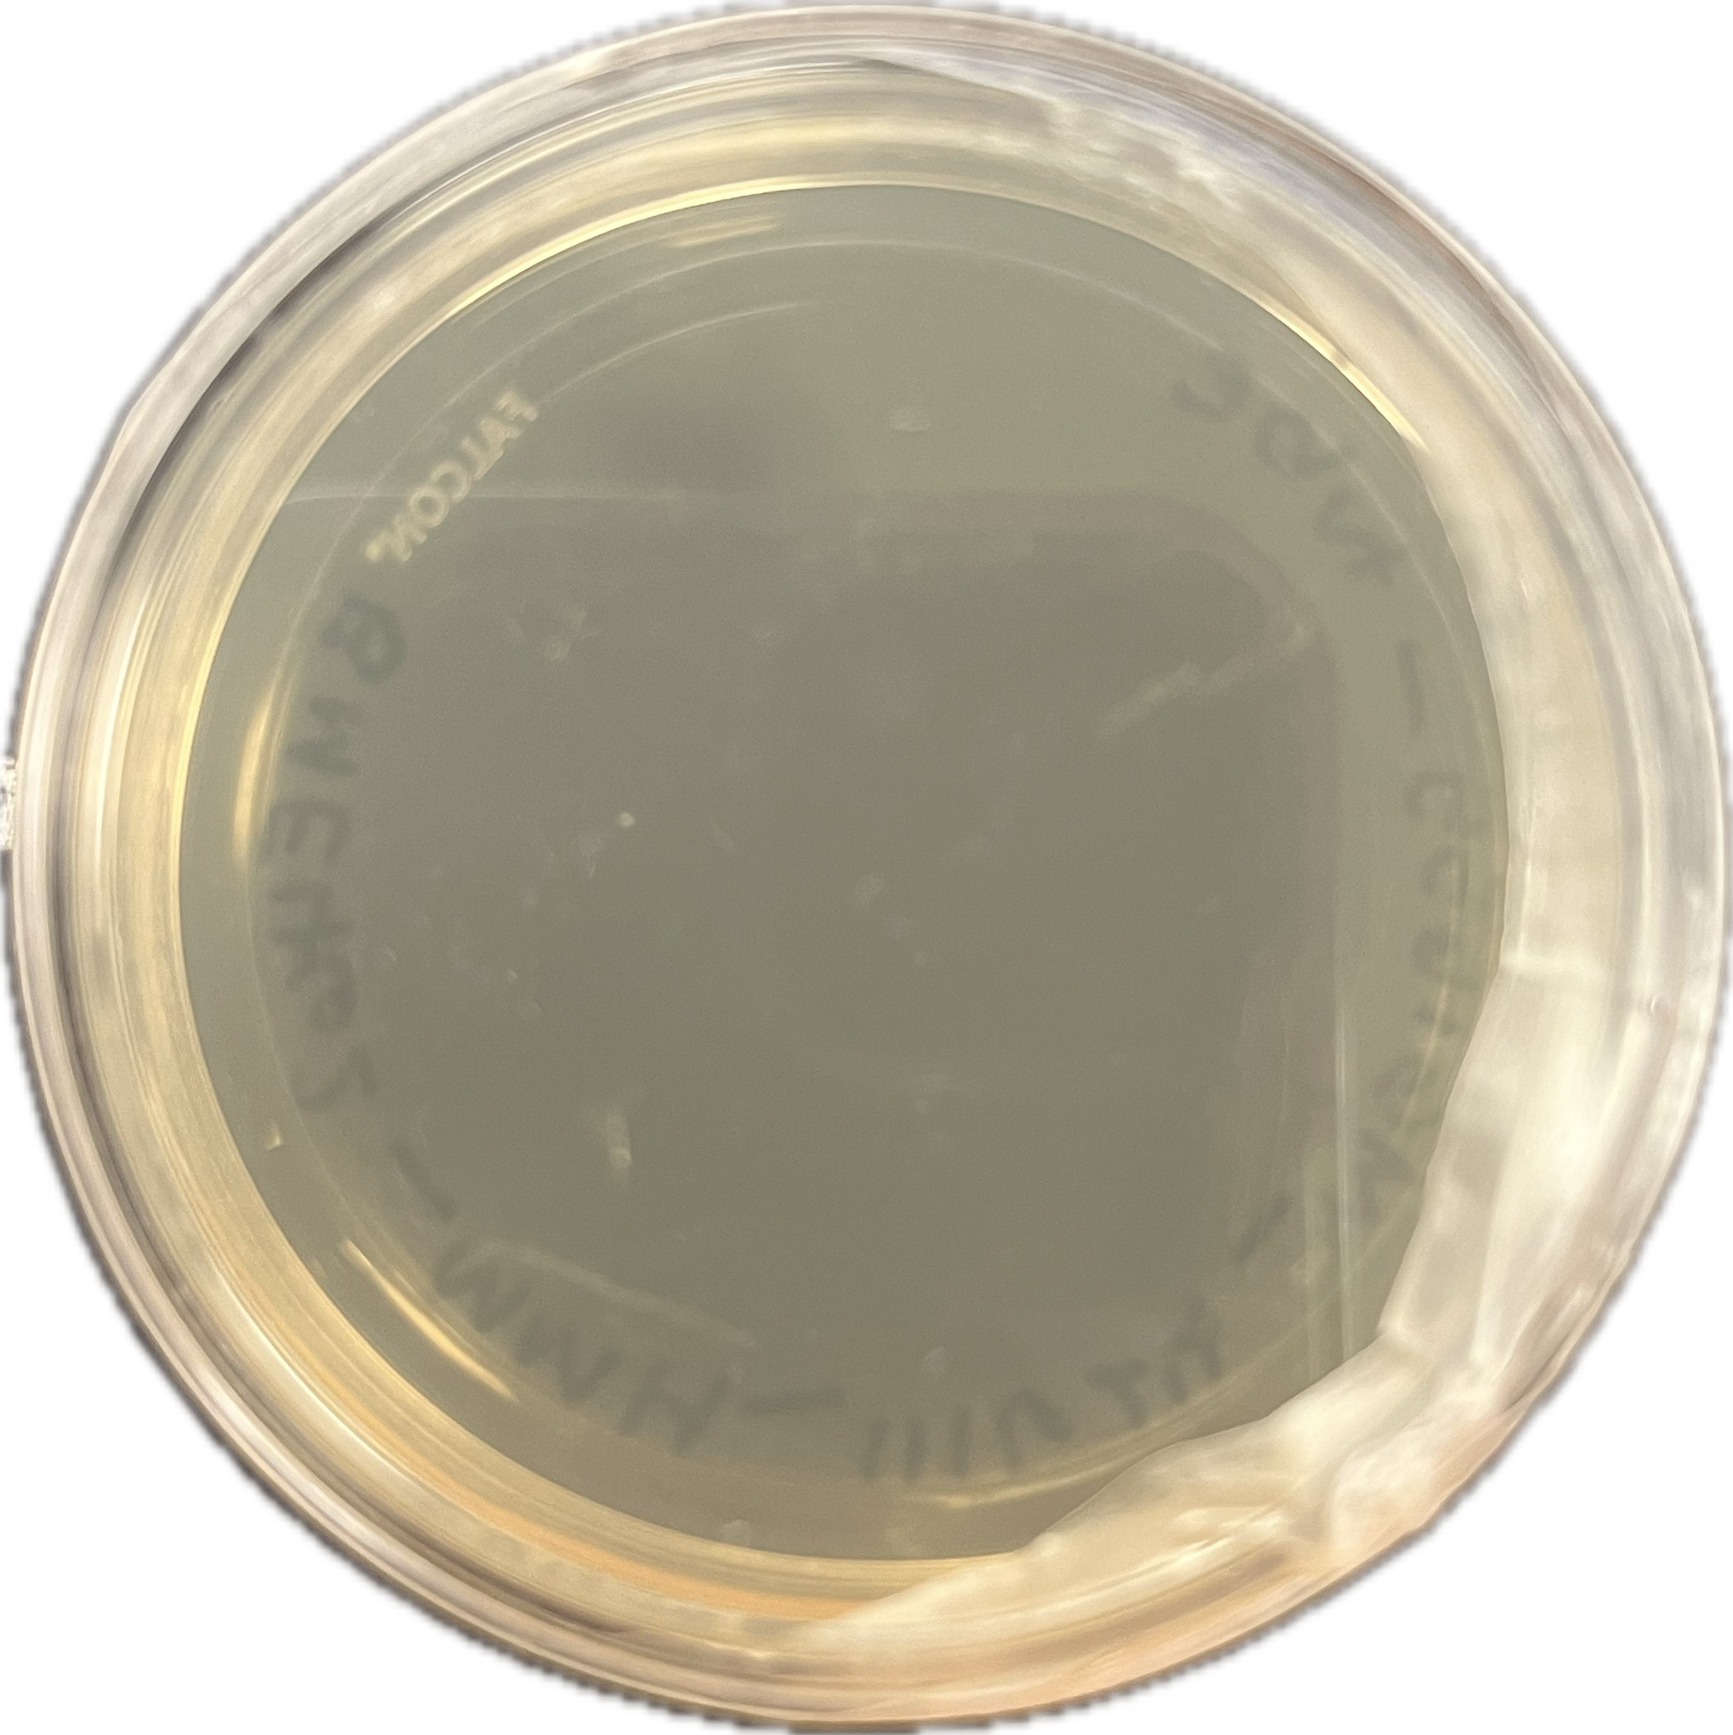
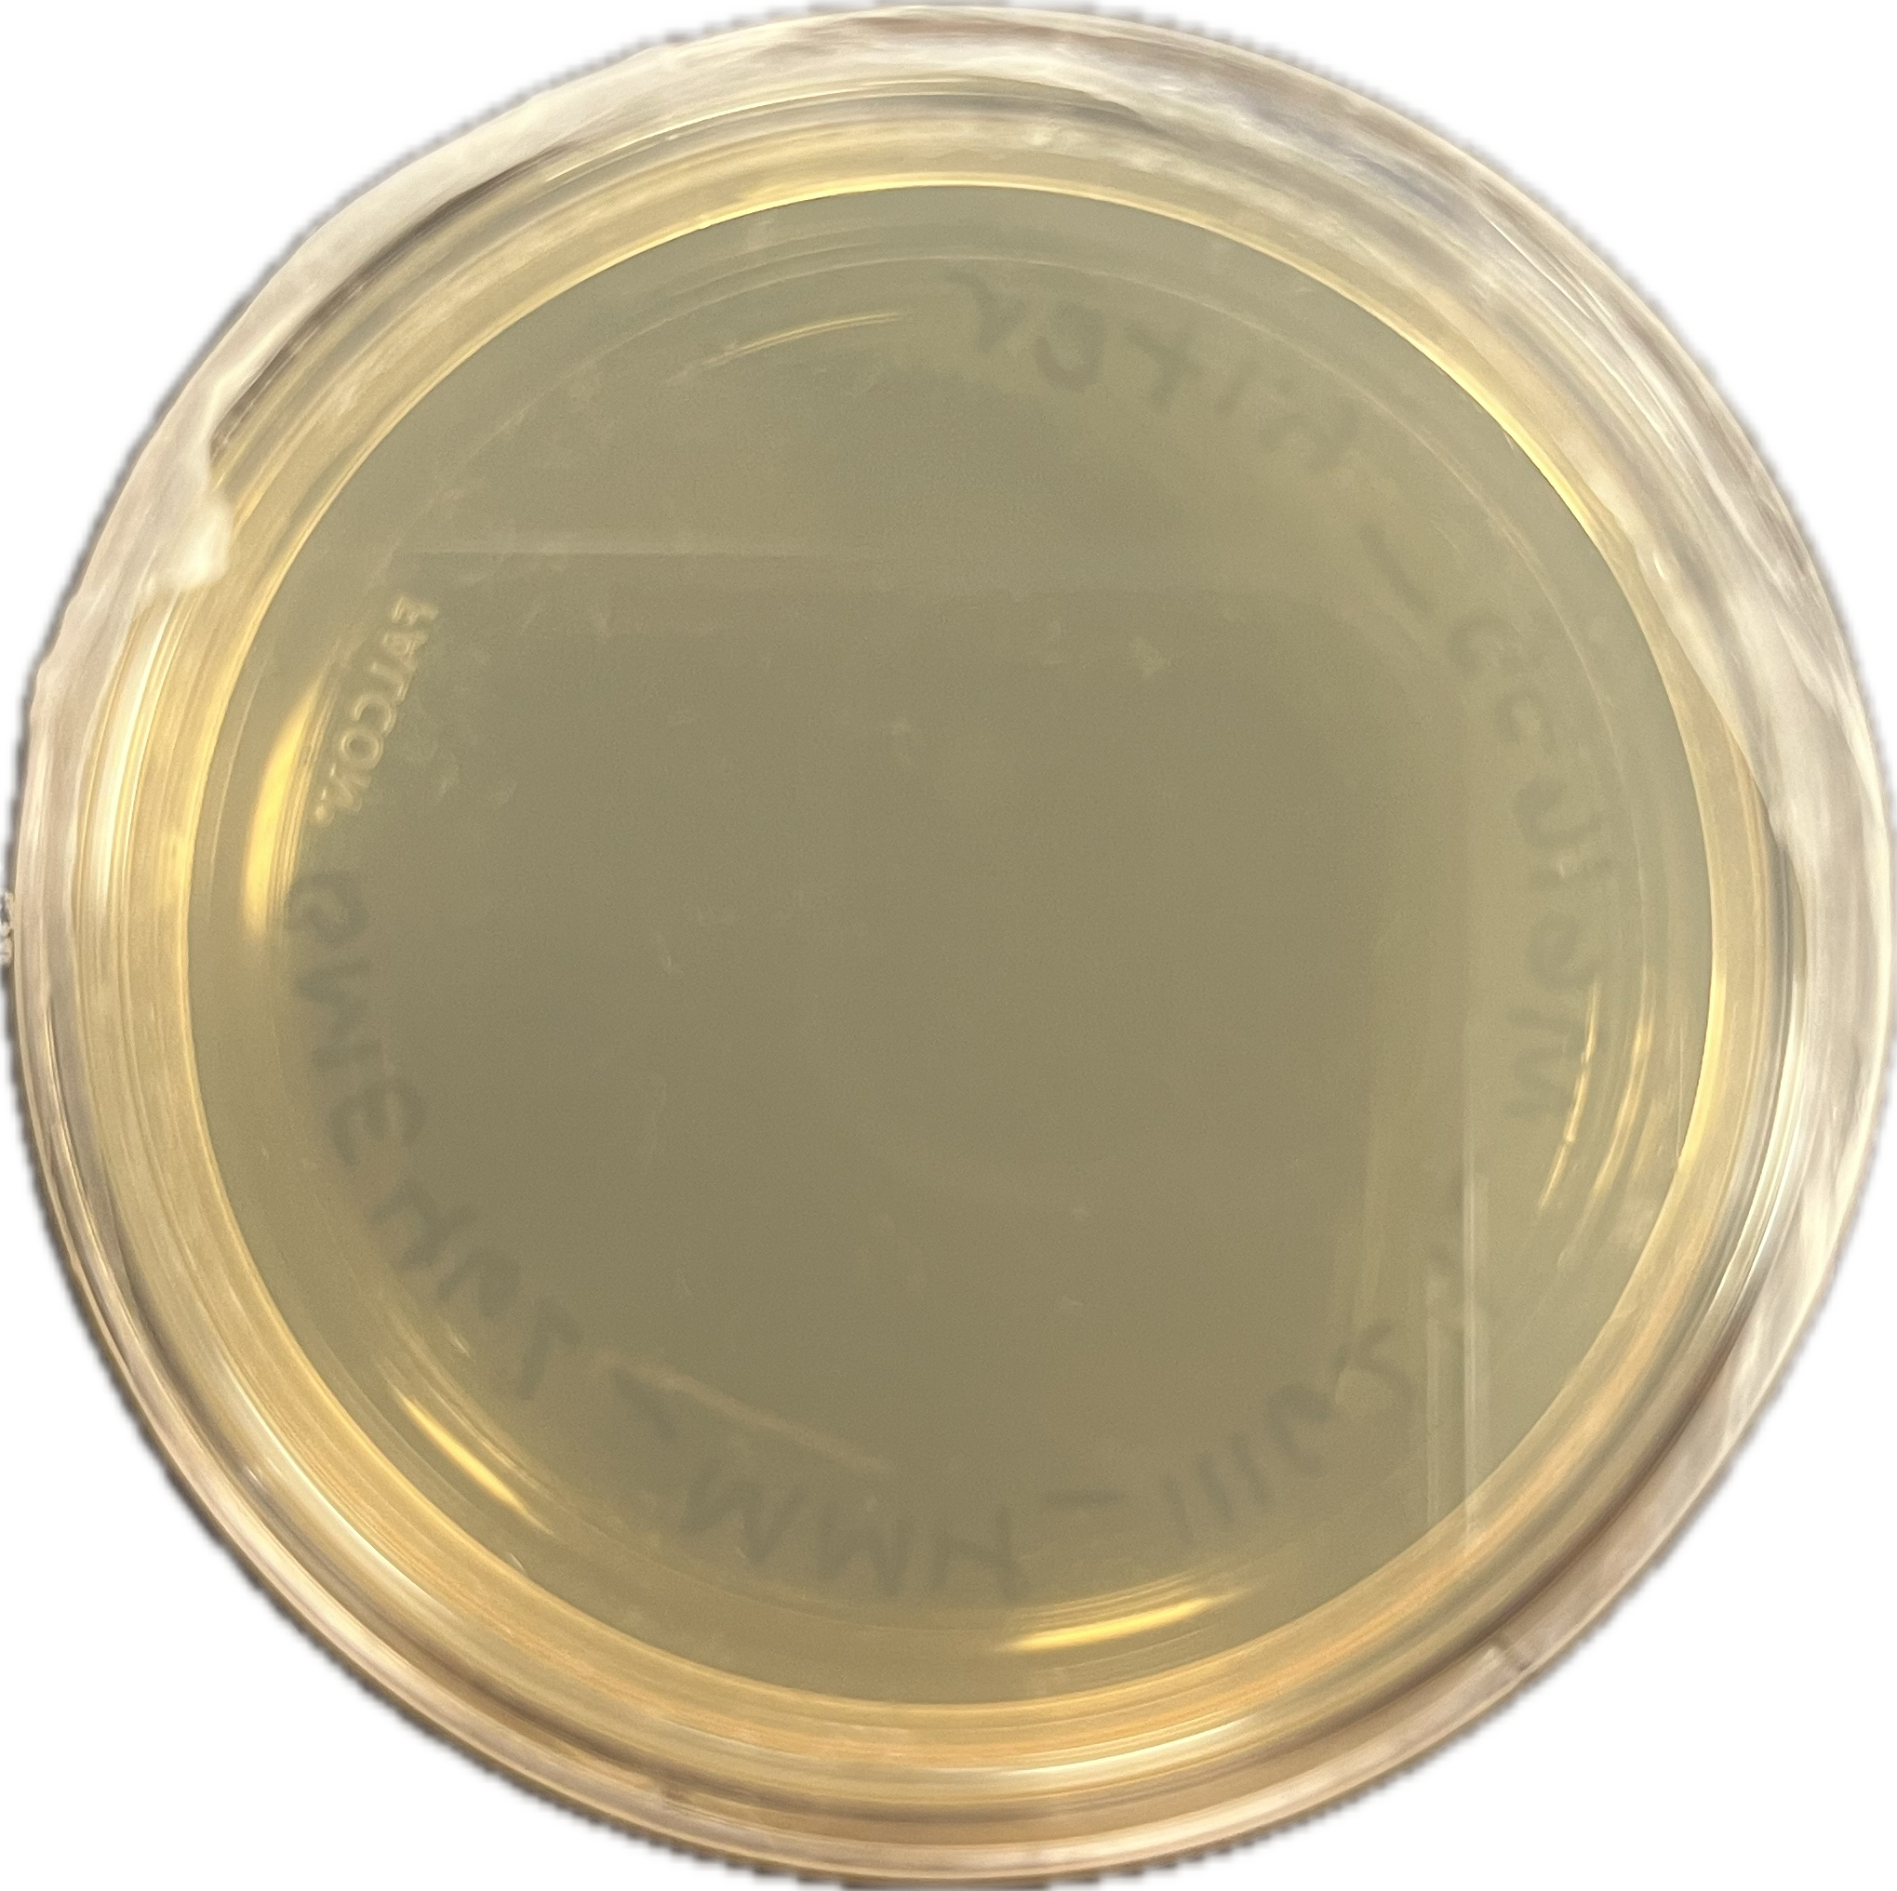
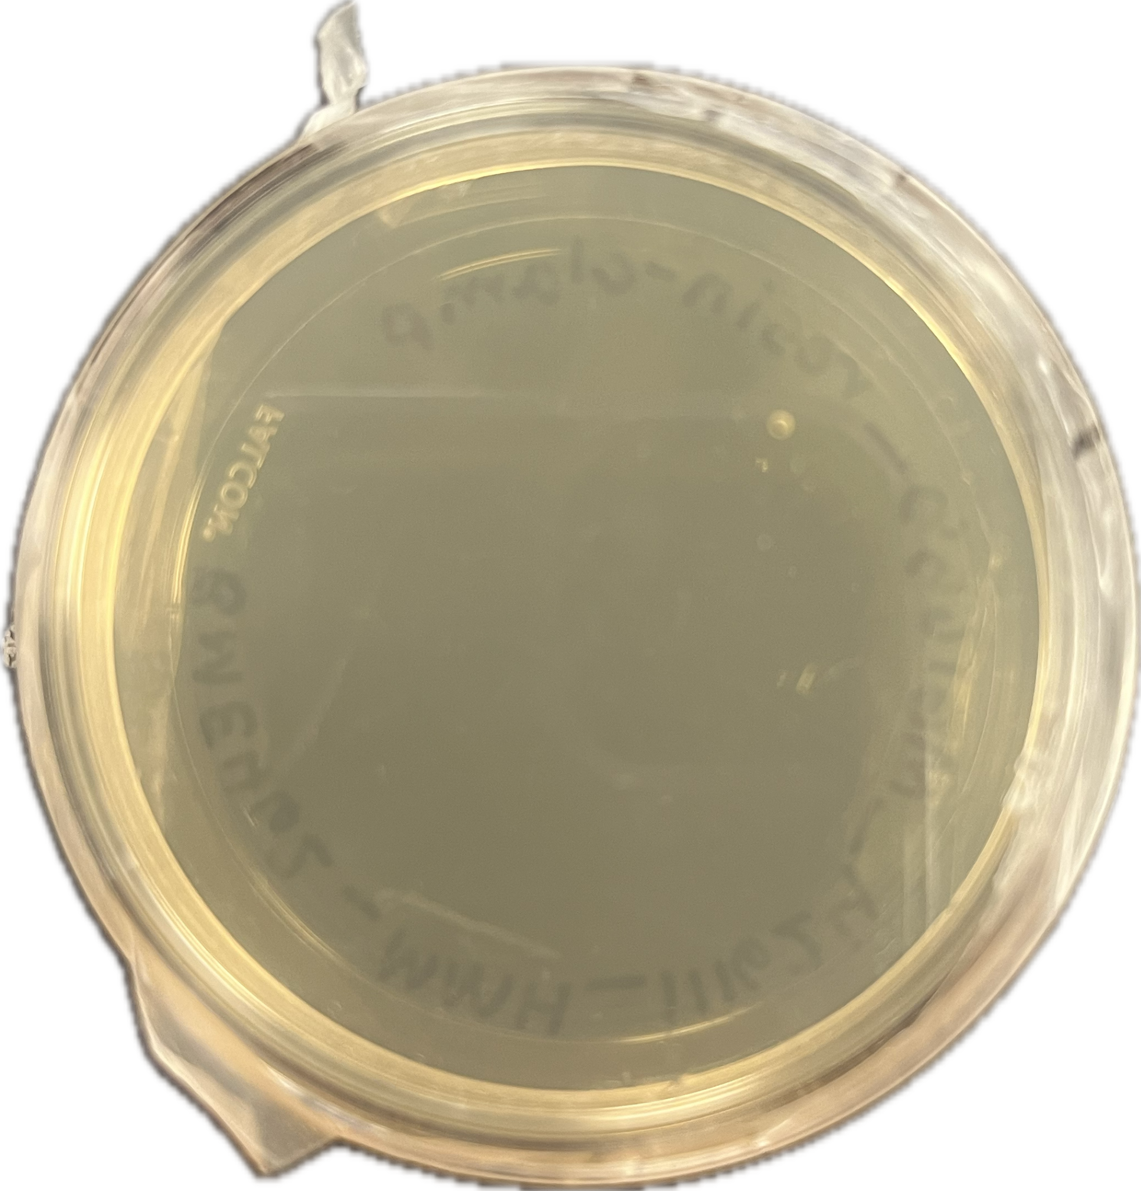
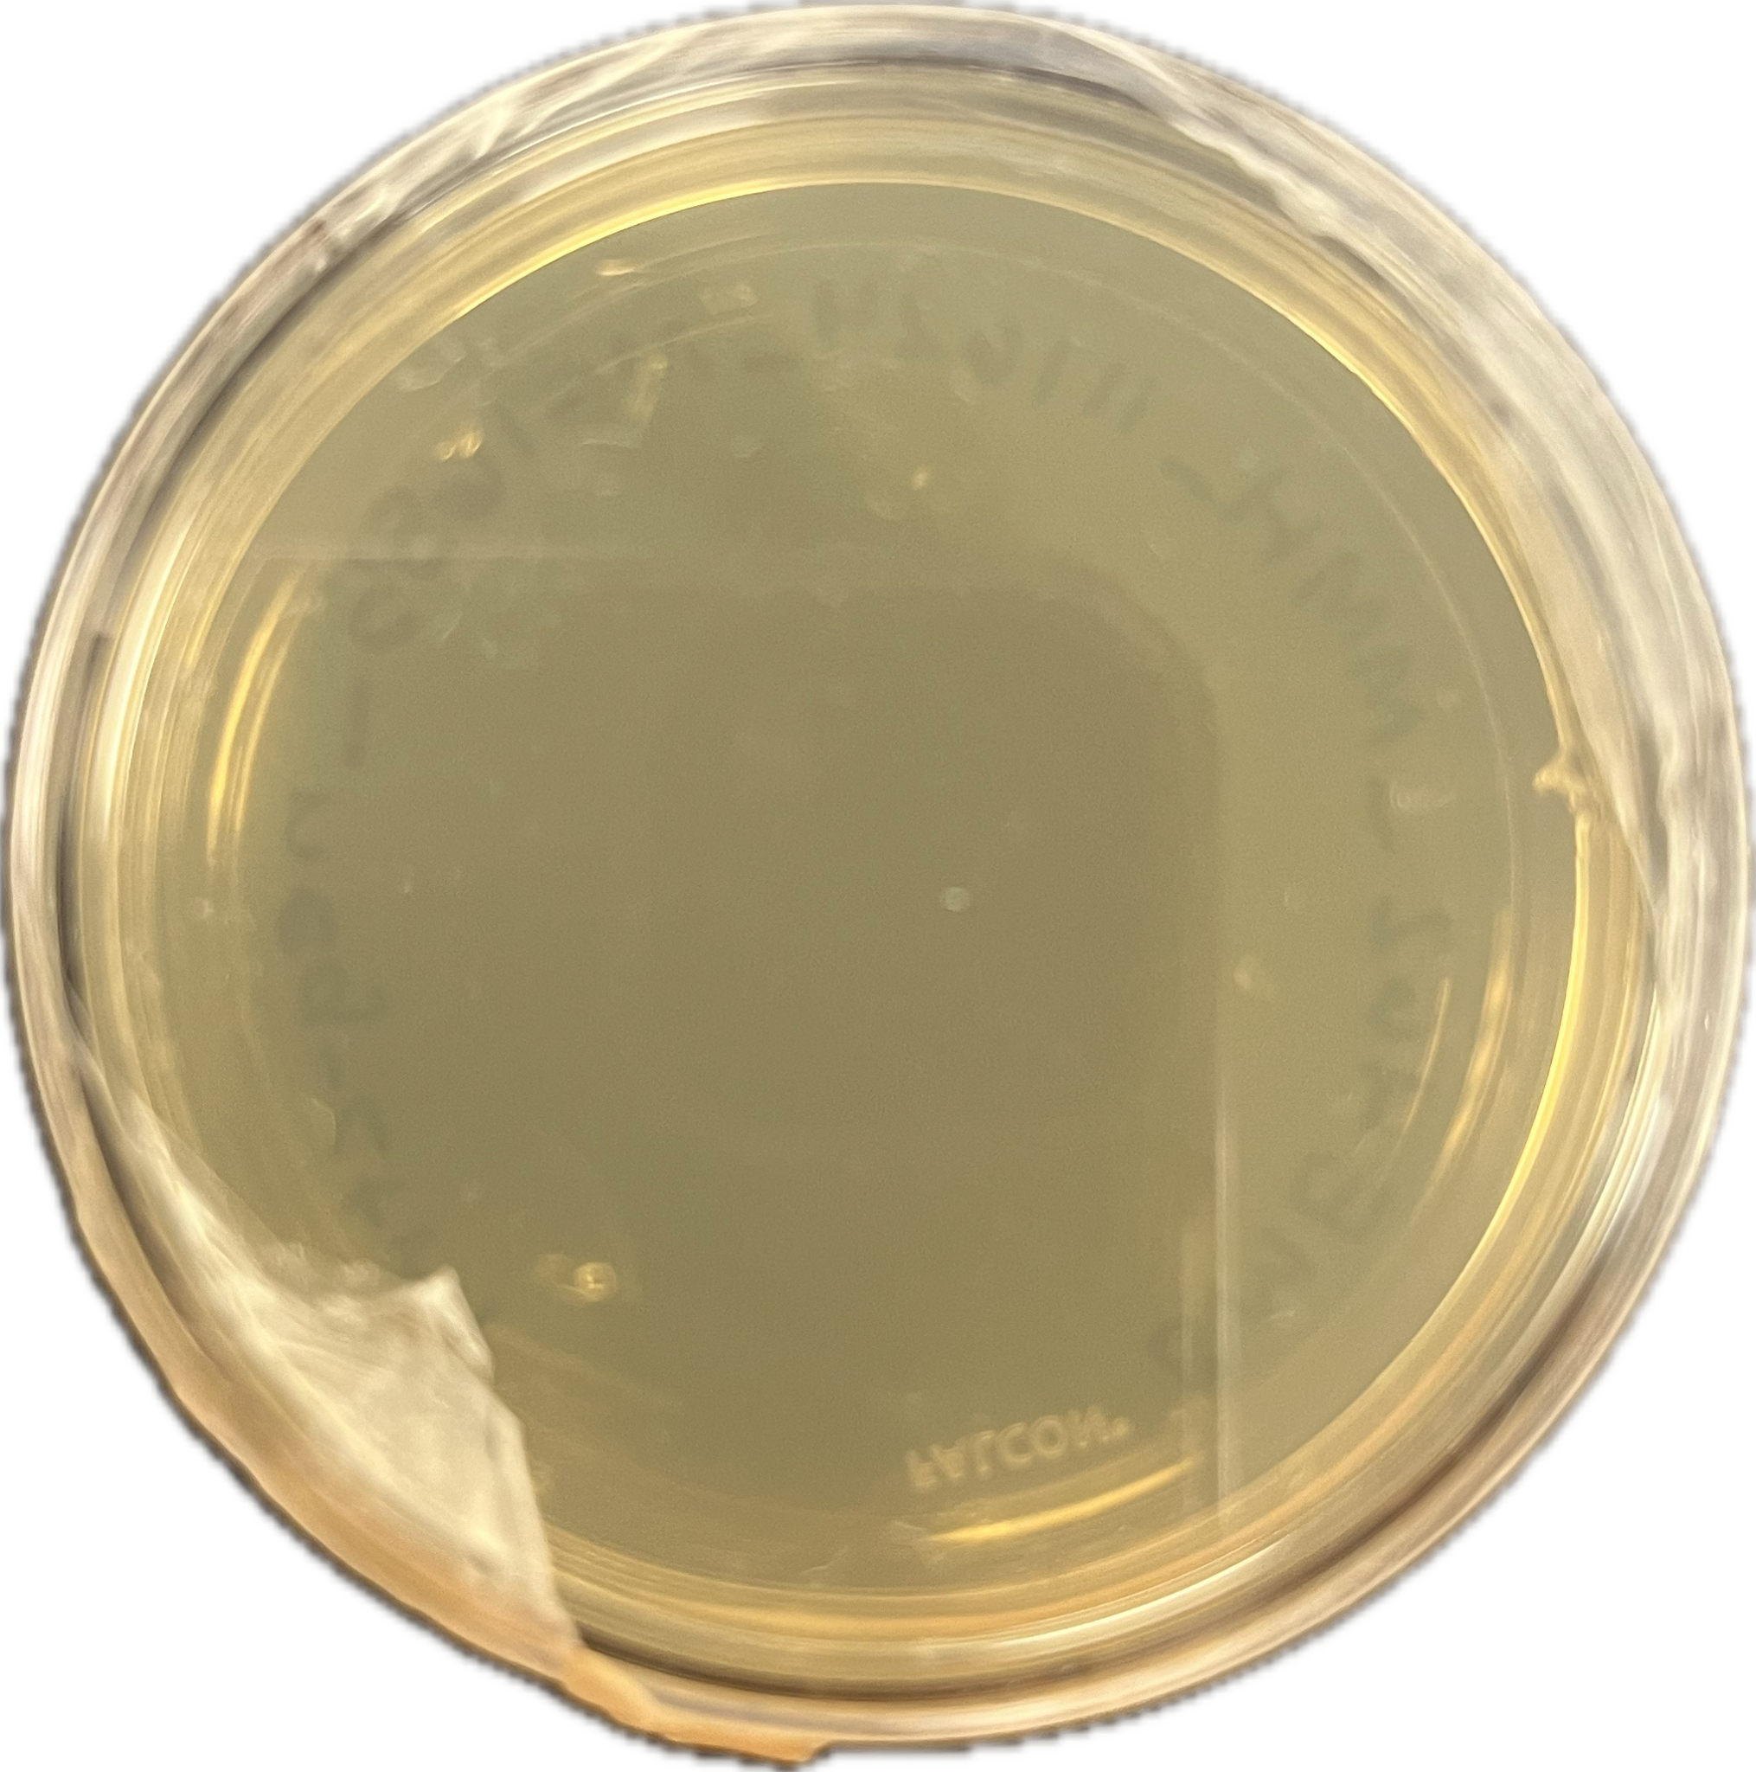
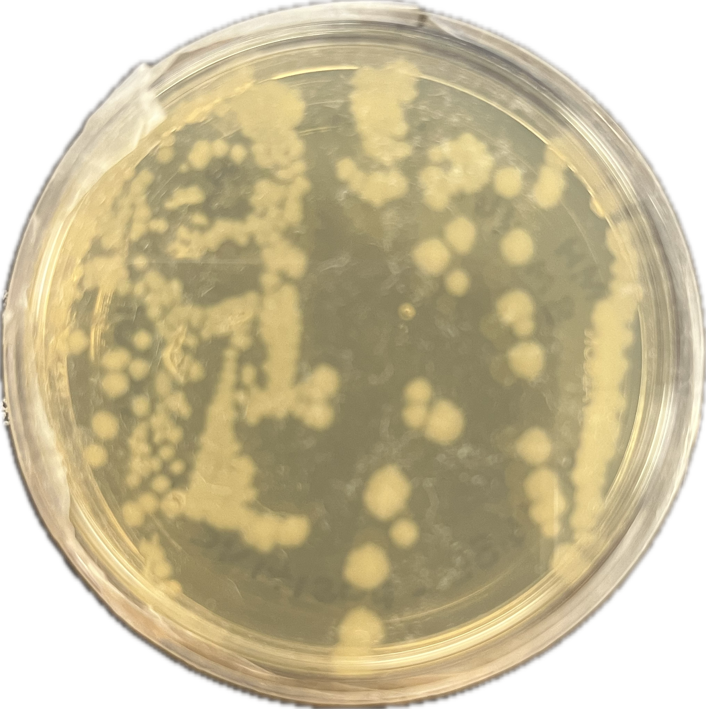

SteriSet
Reusable Blood Giving Set for Pothawira Surgical Center
Hannah Kragt¹, Jason Hoffman¹, Micheala Harris^{1,2}, and Darcy Ayers¹ - Spring 2025
Department of Biomedical Engineering, Duke University 2. Department of Electrical Engineering, Duke University
Design Project Goal
Final Design Solution
Results
Our project aims to create an affordable, reusable, and sterilizable method for blood-giving sets to address the limited availability of single-use sets for the Pothawira Surgical Center in Salima, Malawi.
Material | Use | Attributes
Biomed Clear Resin | 3D Printed Components | Biocompatible, rigid, semi-transparent⁶
Platinum-Cured Silicone | Tubing | Flexible, biocompatible, sterilizable⁷
304 Stainless-Steel Mesh | Filter | Corrosion-resistant, durable, efficient⁸
DOWSIL Sealant | Adhesive | Airtight, food grade⁹
Biomed Elastic Resin | O-Rings | Biocompatible, flexible¹²
Sheep Blood Adhesion Results: Device is unable to be sterilized without blood adhesion
Background and Motivation
High Maternal Mortality
Malawi has the 25th highest maternal mortality rate globally, largely due to postpartum hemorrhage.^{1,3}
Severe Blood Shortage
Salima District (~560k residents) receives only 10 units of blood per week from the government.⁴
Blood is typically donated only in urgent, family-specific cases.⁴
Limited Equipment
Hospitals receive a fixed supply of single-use blood-giving sets from the government.⁴
Once depleted, families must travel over 2 hours to source additional sets, sometimes resulting in fatal delays.⁴
Temperature: 37.0°C
Blood residue remaining in tubing after sterilization and 5x ethanol (70%) wash
Blood Bag Spike:
Standard transfusion set design pierces the blood bag port, allowing blood to flow into the drip chamber.
3D printed from Biomed Clear Resin for durability and precision.
Twist and Lock Mechanism:
Allow for easy disassembly of the chamber for sterilization.
O-rings printed out of Biomed Elastic Resin creates a leak-proof seal between components to maintain functionality.
Two Component Drip Chamber:
The deformable top portion generates a pressure differential to draw blood into the chamber.
The rigid bottom portion provides a secure housing for the blood filter.
Mesh Filter:
160 µm stainless steel mesh removes particles while maintaining blood flow.
Roller Clamp Flow Regulator:
Allows precise control of blood flow rate during transfusion, ensuring safe and consistent delivery.
Detachable dovetail connection to allow for disassembly and sterilization.
Luer Lock Needle Connection:
Provides a secure, standardized connection between the transfusion set and the needle
Prevents leaks and ensures compatibility with medical equipment
E. coli Removal Results: Each part of the device is autoclavable and shows no bacteria growth after autoclaving
Resin (Roller clamp) | Metal Mesh (Filter) | Platinum- Cured Silicone Tube | (-) Control (glass beaker) | (+) Control (colonies in tube)
Previous Prototype
Future Plans
Threaded Connections:
Simple to assemble, but threads degraded over time, generating debris and increasing risk of contamination.
Roller Clamp Flow Regulator:
Tubing passed through a fixed regulator that was not designed to be disassembled, limiting sterilizability and reuse.
Biomed Amber Resin:
Sterilizable and biocompatible, but brittle and cracked frequently during durability testing.
Funnel Filter Design:
Funnel shape reduced mesh surface area, limiting effective filtration.
Project Handoff:
We plan to transition this project to students at the Malawi University of Business and Applied Sciences (MUBAS), who will continue its development and implementation to meet local healthcare needs.
Continued Testing: Finalize biocompatibility verification and conduct standardized testing to ensure airtight performance.
O-ring Design: Improve the O-ring mechanism to ensure an airtight seal and reliable reuse.
Sealant Replacement: Identify a biocompatible alternative to DOWSIL 734 to comply with ISO 10993 standards.
Regulatory Evaluation: Ensure compliance with Malawi’s medical device regulations.
Design Objectives and Testing
Design Objective | Test | Results
Ensure effective bacterial removal from the set after sterilization | Autoclaved components (clamp, mesh, tubing) at 121°C for 40 min; analyzed bacterial growth (E. coli) using ImageJ¹⁰ | PASS - No bacterial growth observed
Transfusion set is leak-proof during use | Assembled set with Ziploc bags filled with water; simulated use and observed for leakage at connections | PASS - No significant leakage in 5 tests; minor leakage in 1 test due to puncture seal
Verify that all materials in the set are biocompatible and met ISO 10993 standards | Reviewed material data sheets and product descriptions for compliance with biocompatibility standards¹¹ | FAIL - Majority of materials passed; Dowsil 734 Sealant failed, requiring replacement
Components can withstand a minimum lateral compressive load of 200 N | Applied lateral force using a vice and measured load at failure with a high-capacity scale | PASS - All components passed
Cost-efficient for affordability in resource-limited settings | Conducted cost analysis using BOM; calculated per-set cost based on material quotes | PASS - Total cost was $34.88 per set
References
[1] CIA., “Maternal mortality ratio”, 2024
[2] Kalulu et al., “Determinants of teenage pregnancy in Malawi” BMC Women’s Health, 2024
[3] Beltman et al., “Beyond maternal mortality” Acta Obstet Gynecol Scand, 2011
[4] A. Alaniz and J. Mayer Hope, “The Blood Transfusion Set Deficiency In Salima, Malawi,” 2024.
[5] Brunskill et al., “What Is the Maximum Time That RBCs Can Be Left Out?,” Transfusion Med. Reviews, 2012
[6] Formlabs et al., BioMed Amber Resin Tech. Data Sheet, 2023.
[7] Avantor Fluid Handling et al., Cert. Qual. Tubing MFLEX Silicone No. 16, 2024.
[8] Xu et al., J. Mater. Res. Technol., 2024.
[9] Dow Chemical Company et al., DOWSIL 734 Flowable Sealant Tech. Data Sheet, 2020.
[10] CDC et al., Steam Sterilization 2024
[11] FDA et al., Use of ISO 10993-1 Guidance, 2023.
[12] Formlabs. BioMed Clear Resin Technical Data Sheet. 2023.
Acknowledgements
We would like to extend our thanks to the following:
Anne Alaniz DO (Co-Founder of Pothawira)
Joanie Hope MD (Pothawira affiliate)
Nancy Kragt DO (Pothawira affiliate)
Megan Madonna Ph.D.
Matt Brown
Kerry Eller
Duke Pratt School of Engineering
Notes:
Introduction and Design Goal
Goal: Create affordable, reusable, and sterilizable transfusion sets for Pothawira Surgical Center.
Address critical need for safe transfusion tools in resource-limited settings. Resin:16.9
Background and Motivation
Maternal Mortality: 25th highest globally; postpartum hemorrhaging a leading cause.
Blood Supply Challenges:
Only 10 units per week for 560,000 people in Salima.
Blood lasts less than 4 hours without proper storage.
Inadequate Facilities:
Patients travel 2+ hours for transfusion sets.
Women often give birth in unsanitary conditions.
Current Solutions: Disposable sets are unsustainable due to sourcing and storage issues.
Design Choices
Drip Chamber Debate:
Chose two-component design for easier sterilization and pressure regulation.
Flow Modulator Options:
Selected roller clamp for simplicity and durability over twist-to-tighten design.
Final Design Solution
Material choices
Key Features:
Blood bag spike for smooth blood flow.
Threaded connections for disassembly and leak-proof reassembly.
Two-component drip chamber for filtration and pressure regulation.
160 µm stainless steel mesh for particle-free blood flow.
Roller clamp for precise flow control.
Luer lock connection for compatibility and leak prevention.
demonstration while i talk about key features
Design Objectives and Testing
Bacterial Removal: Pass—no growth after autoclaving.
Leak-Proof: Pass—minimal leakage in 5/6 trials.
Biocompatibility: Partial fail—most materials passed; DOWSIL sealant failed.
Strength: Pass—all components exceeded 200 N compressive load.
Cost: Pass—$23.71 per set.
Future Work and Conclusion
Improvements Needed:
Switch to twist-and-lock for durability.
Expand drip chamber size for better filtration.
Optimize roller clamp design for stronger walls.
Replace DOWSIL sealant with compliant material.
Reflection: Started as a summer idea with Hannah; realized with the help of Darcy and Michaela.
Excitement for Next Semester: Continue refining the design and working toward implementation.

